Slide 1
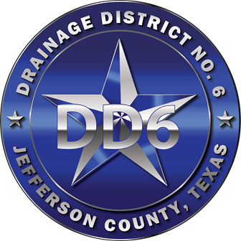
JEFFERSON COUNTY
DRAINAGE DISTRICT NO. 6
Making Arks Obsolete
October 20, 2021
ROTARY CLUB OF BEAUMONT
PRESENTED BY:
DR. JOSEPH G. MAJDALANI, PE, CFM
GENERAL MANAGER

Slide 2

THE THREE PILLARS
DD6 DRAINAGE SYSTEM
The District accomplishes its mission by:
Devising Hazard Mitigation Plans
Implementing the Plans
Maintaining the Infrastructure
PROJECTS
ASSETS
MAINTENANCE

Slide 3
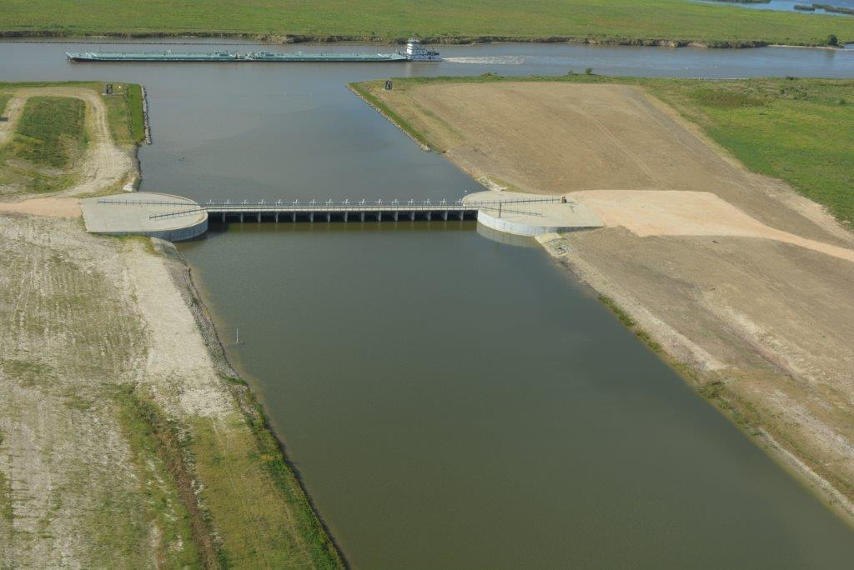
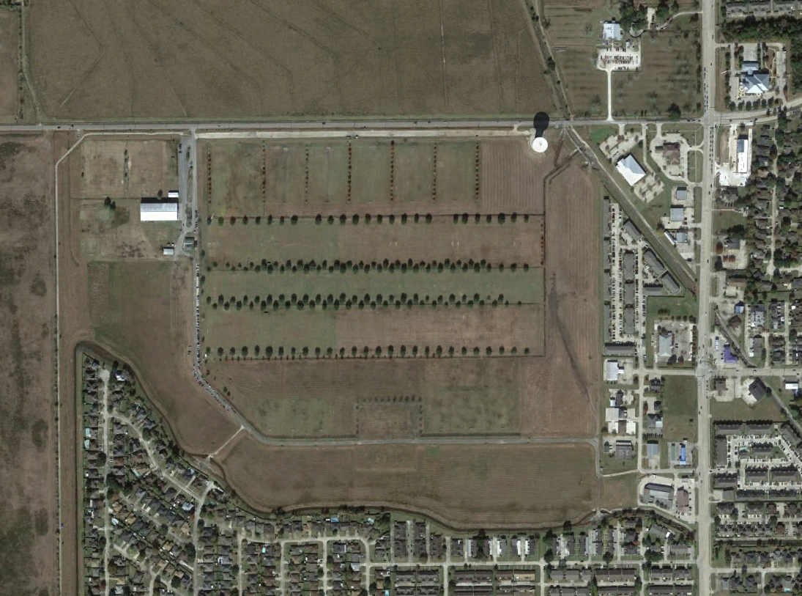
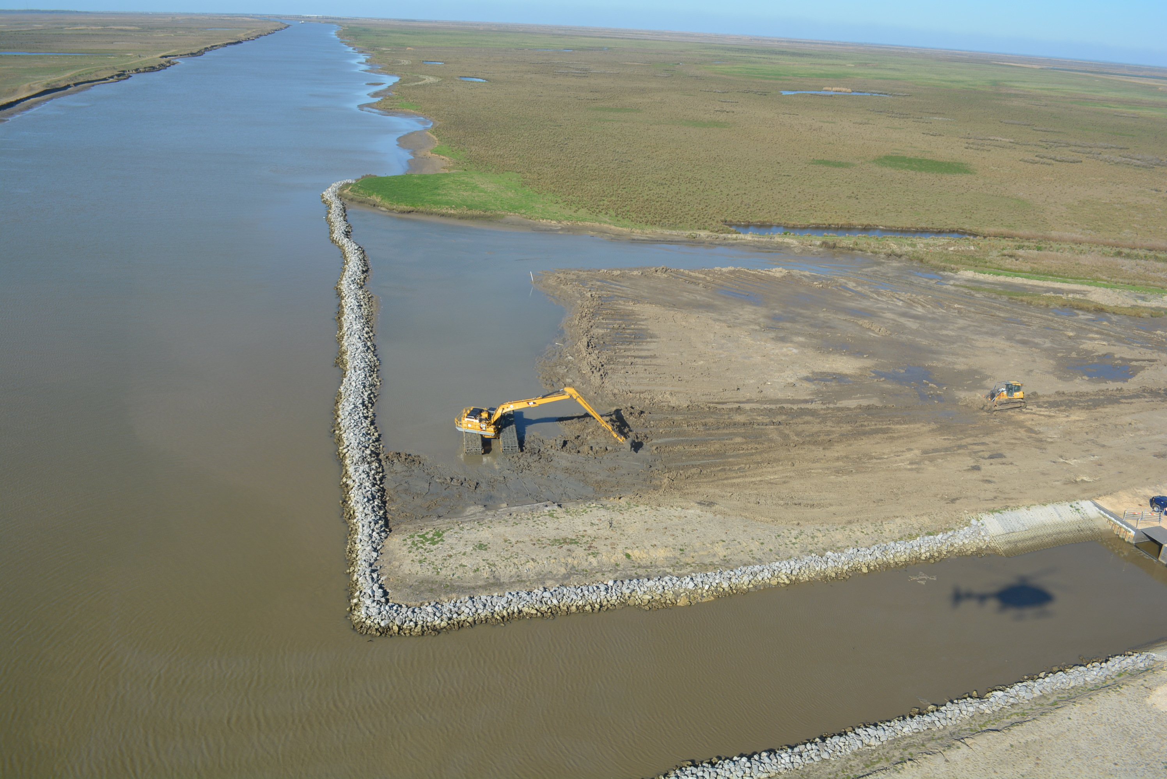
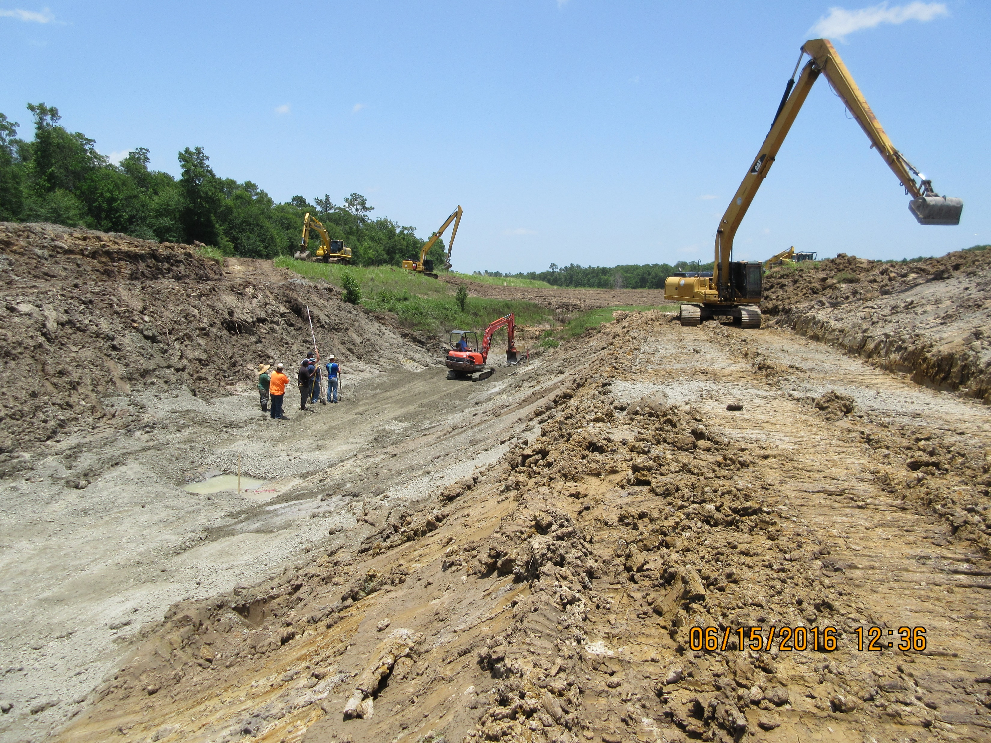
ASSETS
• 1,070 MILES OF NUMBERED CHANNELS
• 679 MILES CURRENT/EXISTING ROW (63%)
• 391 MILES FUTURE ROW (37%)
• OVER 34 MILES OF CONCRETE-LINED CHANNELS
• 40 DETENSION BASINS
• 2 UNDER CONSTRUCTION
• 1 UNDER DESIGN
• SEVERAL PLANNED
165 MIL GAL

Slide 4
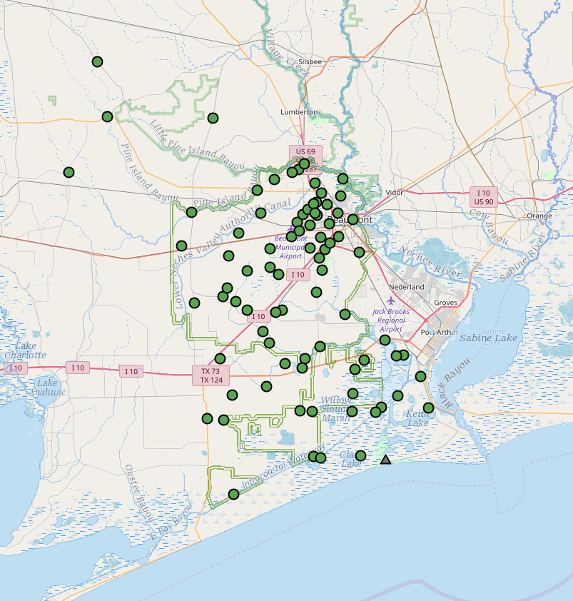
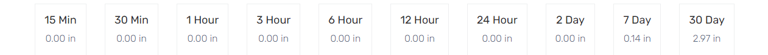
ASSETS
RAIN INCREMENT – RAIN ACCUMULATION - WATER LEVEL- TEMPRETURE – WIND SPEED - PRESSURE
● 80 ALERT STATIONS
● 5 UNDER CONSTRUCTION
DATA IS USED BY: NOAA – ENGINEERS – TXDOT – EMERGENCY MANAGEMENT CENTERS – TV STATION

Slide 5
CHALLENGES
• WE COVER A LARGE AREA - OVER 502 SQ. MILES
• FLAT TERRAIN
• HIGH ANNUAL PRECIPITATION - AVERAGE 59”
• 2017 Jan-Dec TOTAL PRECIPITATION 88.20”
• 2018 Jan-Dec TOTAL PRECIPITATION 75.71”
• 2019 Jan-Dec TOTAL PRECIPITATION 78.57”
• 2020 Jan-Dec TOTAL PRECIPITATION 56.22”
• 2021 Jan-Sept TOTAL PRECIPITATION 48.61”
• HIGH INTENSITY RAIN EVENTS
• COMPLEX & AGING DRAINAGE SYSTEM
• LIMITED ACCESS / REMOTE LOCATIONS / LACK OF CONTINUOUS ROW
• Man-made Obstacles (Roads, Pipelines, Bridges, Railroads, Elevated Canals, HWYs, etc.)

Slide 6
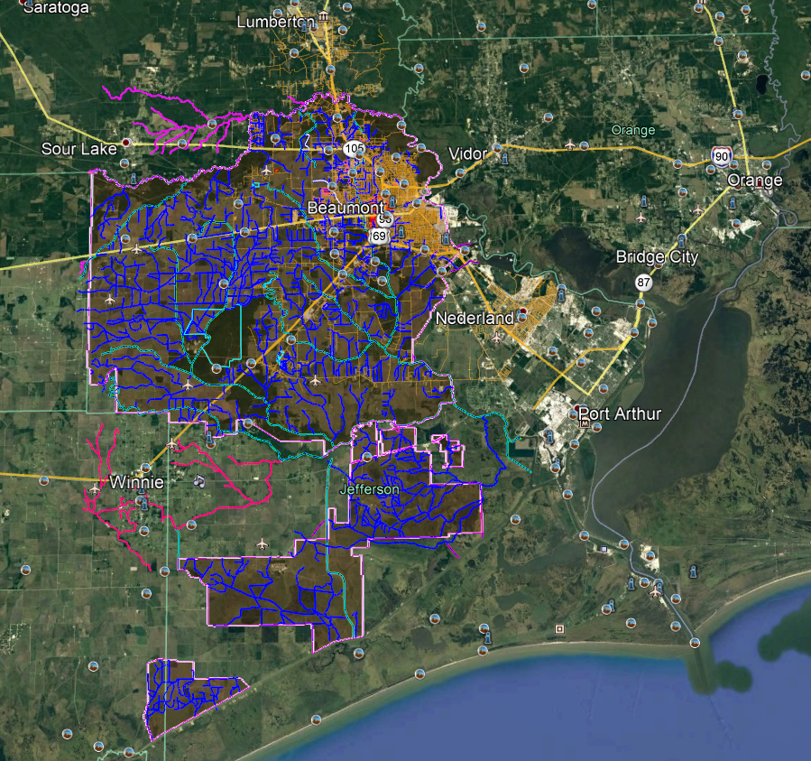
SERVICE AREA
• DD6 SERVICE AREA COVERS
502 SQUARE MILES
• JEFFERSON COUNTY COVERS
988 SQUARE MILES
• HOUSTON AREA COVERS
669 SQUARE MILES

Slide 7
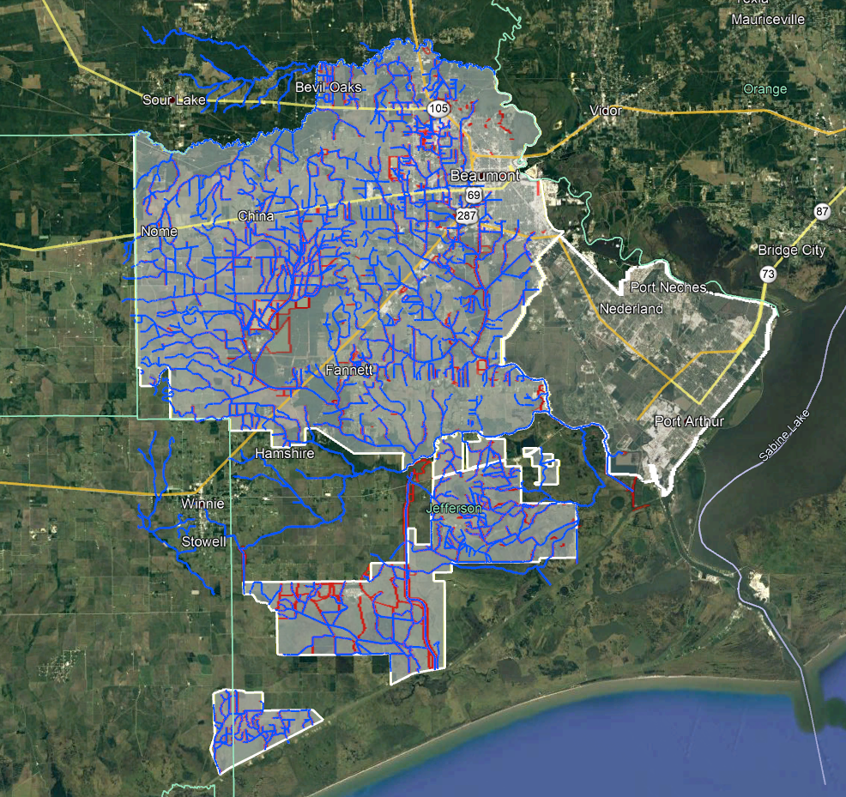
SERVICE AREAS
• DD6 SERVICE AREA COVERS 502 SQUARE MILES
Annual Operating Budget $22,586,280
Tax Rate Per $100 Valuation $0.214244
• DD7 SERVICE AREA COVERS 113 SQUARE MILES
Annual Operating Budget $33,449,460
Tax Rate Per $100 Valuation $0.284775
• DD3 SERVICE AREA COVERS 74 SQUARE MILES
Annual Operating Budget $640,165
Tax Rate Per $100 Valuation $0.303335
• MARSH AREAS - NO DRAINAGE AUTHORITY
DD6
DD7
DD3
DD6
DD6
MARSH AREA NO DRAINAGE AUTHORITY
TRINITY BAY CONSERVATION DISTRICT
DD6

Slide 8
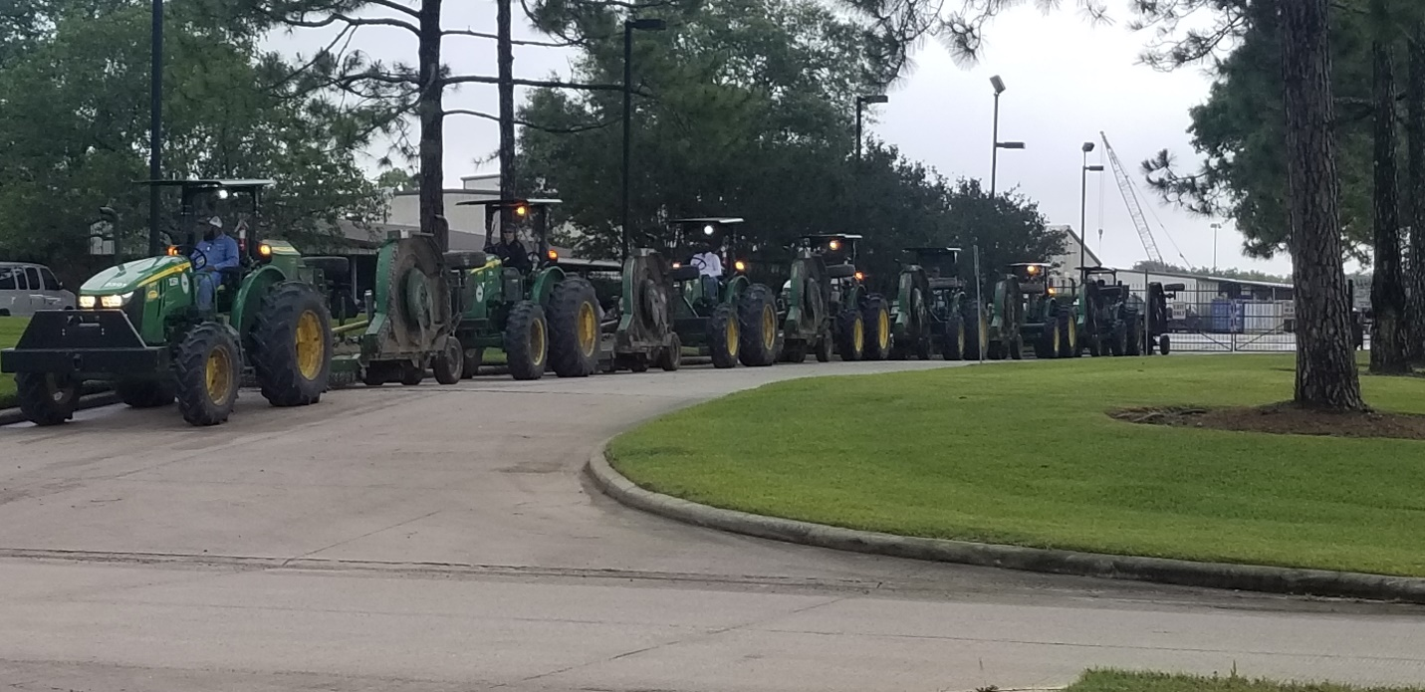
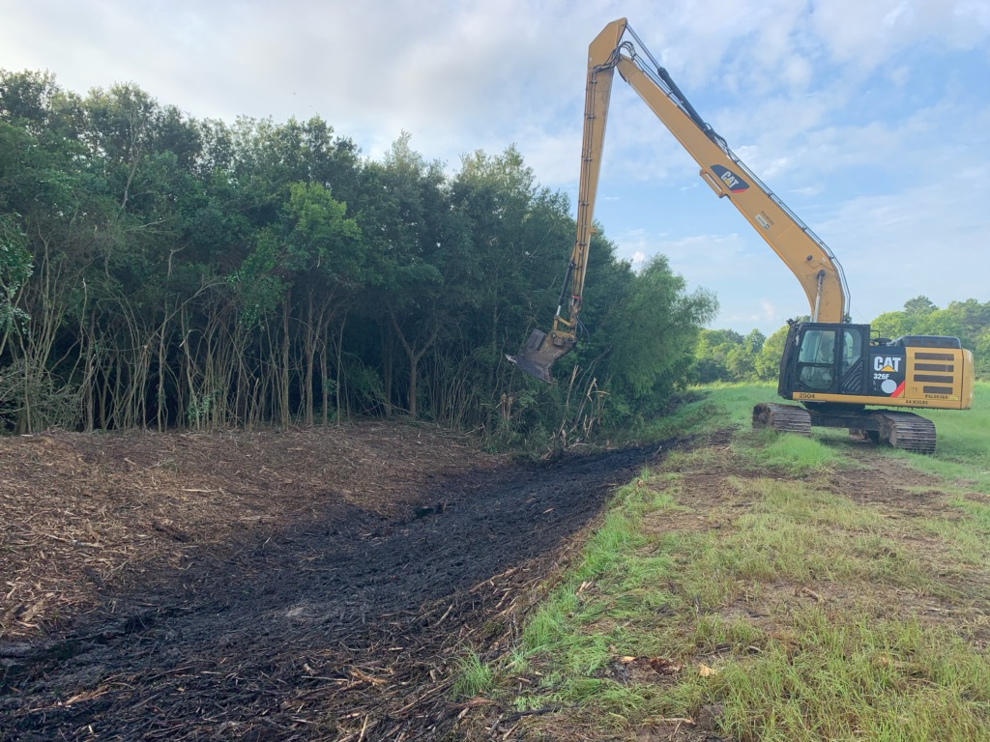
• MOWING
• SLASHBUSTING
• SPRAYING/HERBICIDE APPLICATION
• DRIFT CONTROL/REMOVAL
● ENSURE ALL CROSSINGS ARE FREE OF DEBRIS
• DREDGING
HOW DO WE MAINTAIN OPTIMUM DRAINAGE SYSTEM PERFORMANCE?

Slide 9
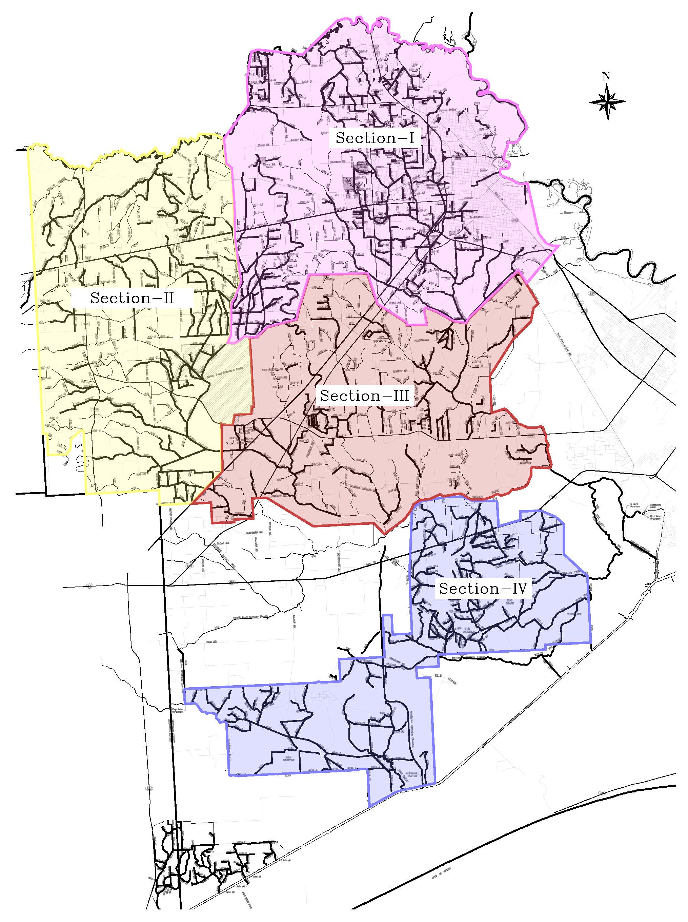
MOWING AREAS
SYSTEMATIC APPROACH
4 SECTIONS
• NORTH JEFFERSON COUNTY (SECTION - I)
• WEST JEFFERSON COUNTY (SECTION - II)
• SOUTH CENTRAL JEFFERSON COUNTY (SECTION - III)
• SOUTH JEFFERSON COUNTY (SECTION - IV)
ALL MOWING ACTIVITIES ARE TRACKED BY GPS SYSTEM TO
MONITOR PROGRESS

Slide 10
MOWING SCHEDULE
STARTS 1ST WEEK OF APRIL AND ENDS MID-DECEMBER
OUR COMMITMENT:
URBAN AREAS
2 CUTS PER YEAR
RURAL AREAS
2 CUTS PER YEAR (DITCH TOPS)
1 CUT PER YEAR (DITCH BOTTOM)
TODAY:
URBAN AREAS
4TH CUT FOR THIS YEAR
RURAL AREAS
3RD CUT FOR THIS YEAR (DITCH TOPS)
1ST CUT FOR THIS YEAR (DITCH BOTTOM)

Slide 11
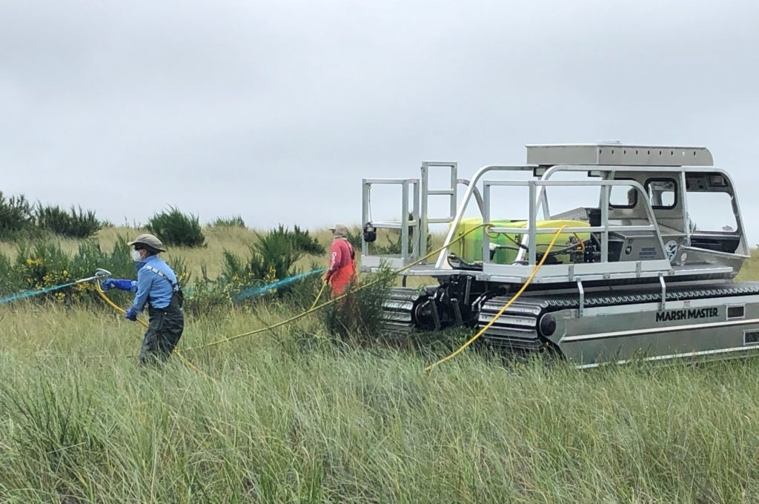
ASSETS DEDICATED FOR
HERBICIDE APPLICATION
GROUND HERBICIDE APPLICATION
STARTS 1ST WEEK OF APRIL AND ENDS NOVEMBER/FIRST FROST
• TWO LICENSED HERBICIDE APPLICATOR CREWS
• TWO 2-MAN CREWS
• MARSH MASTER® EQUIPPED WITH SPRAY RIG

Slide 12
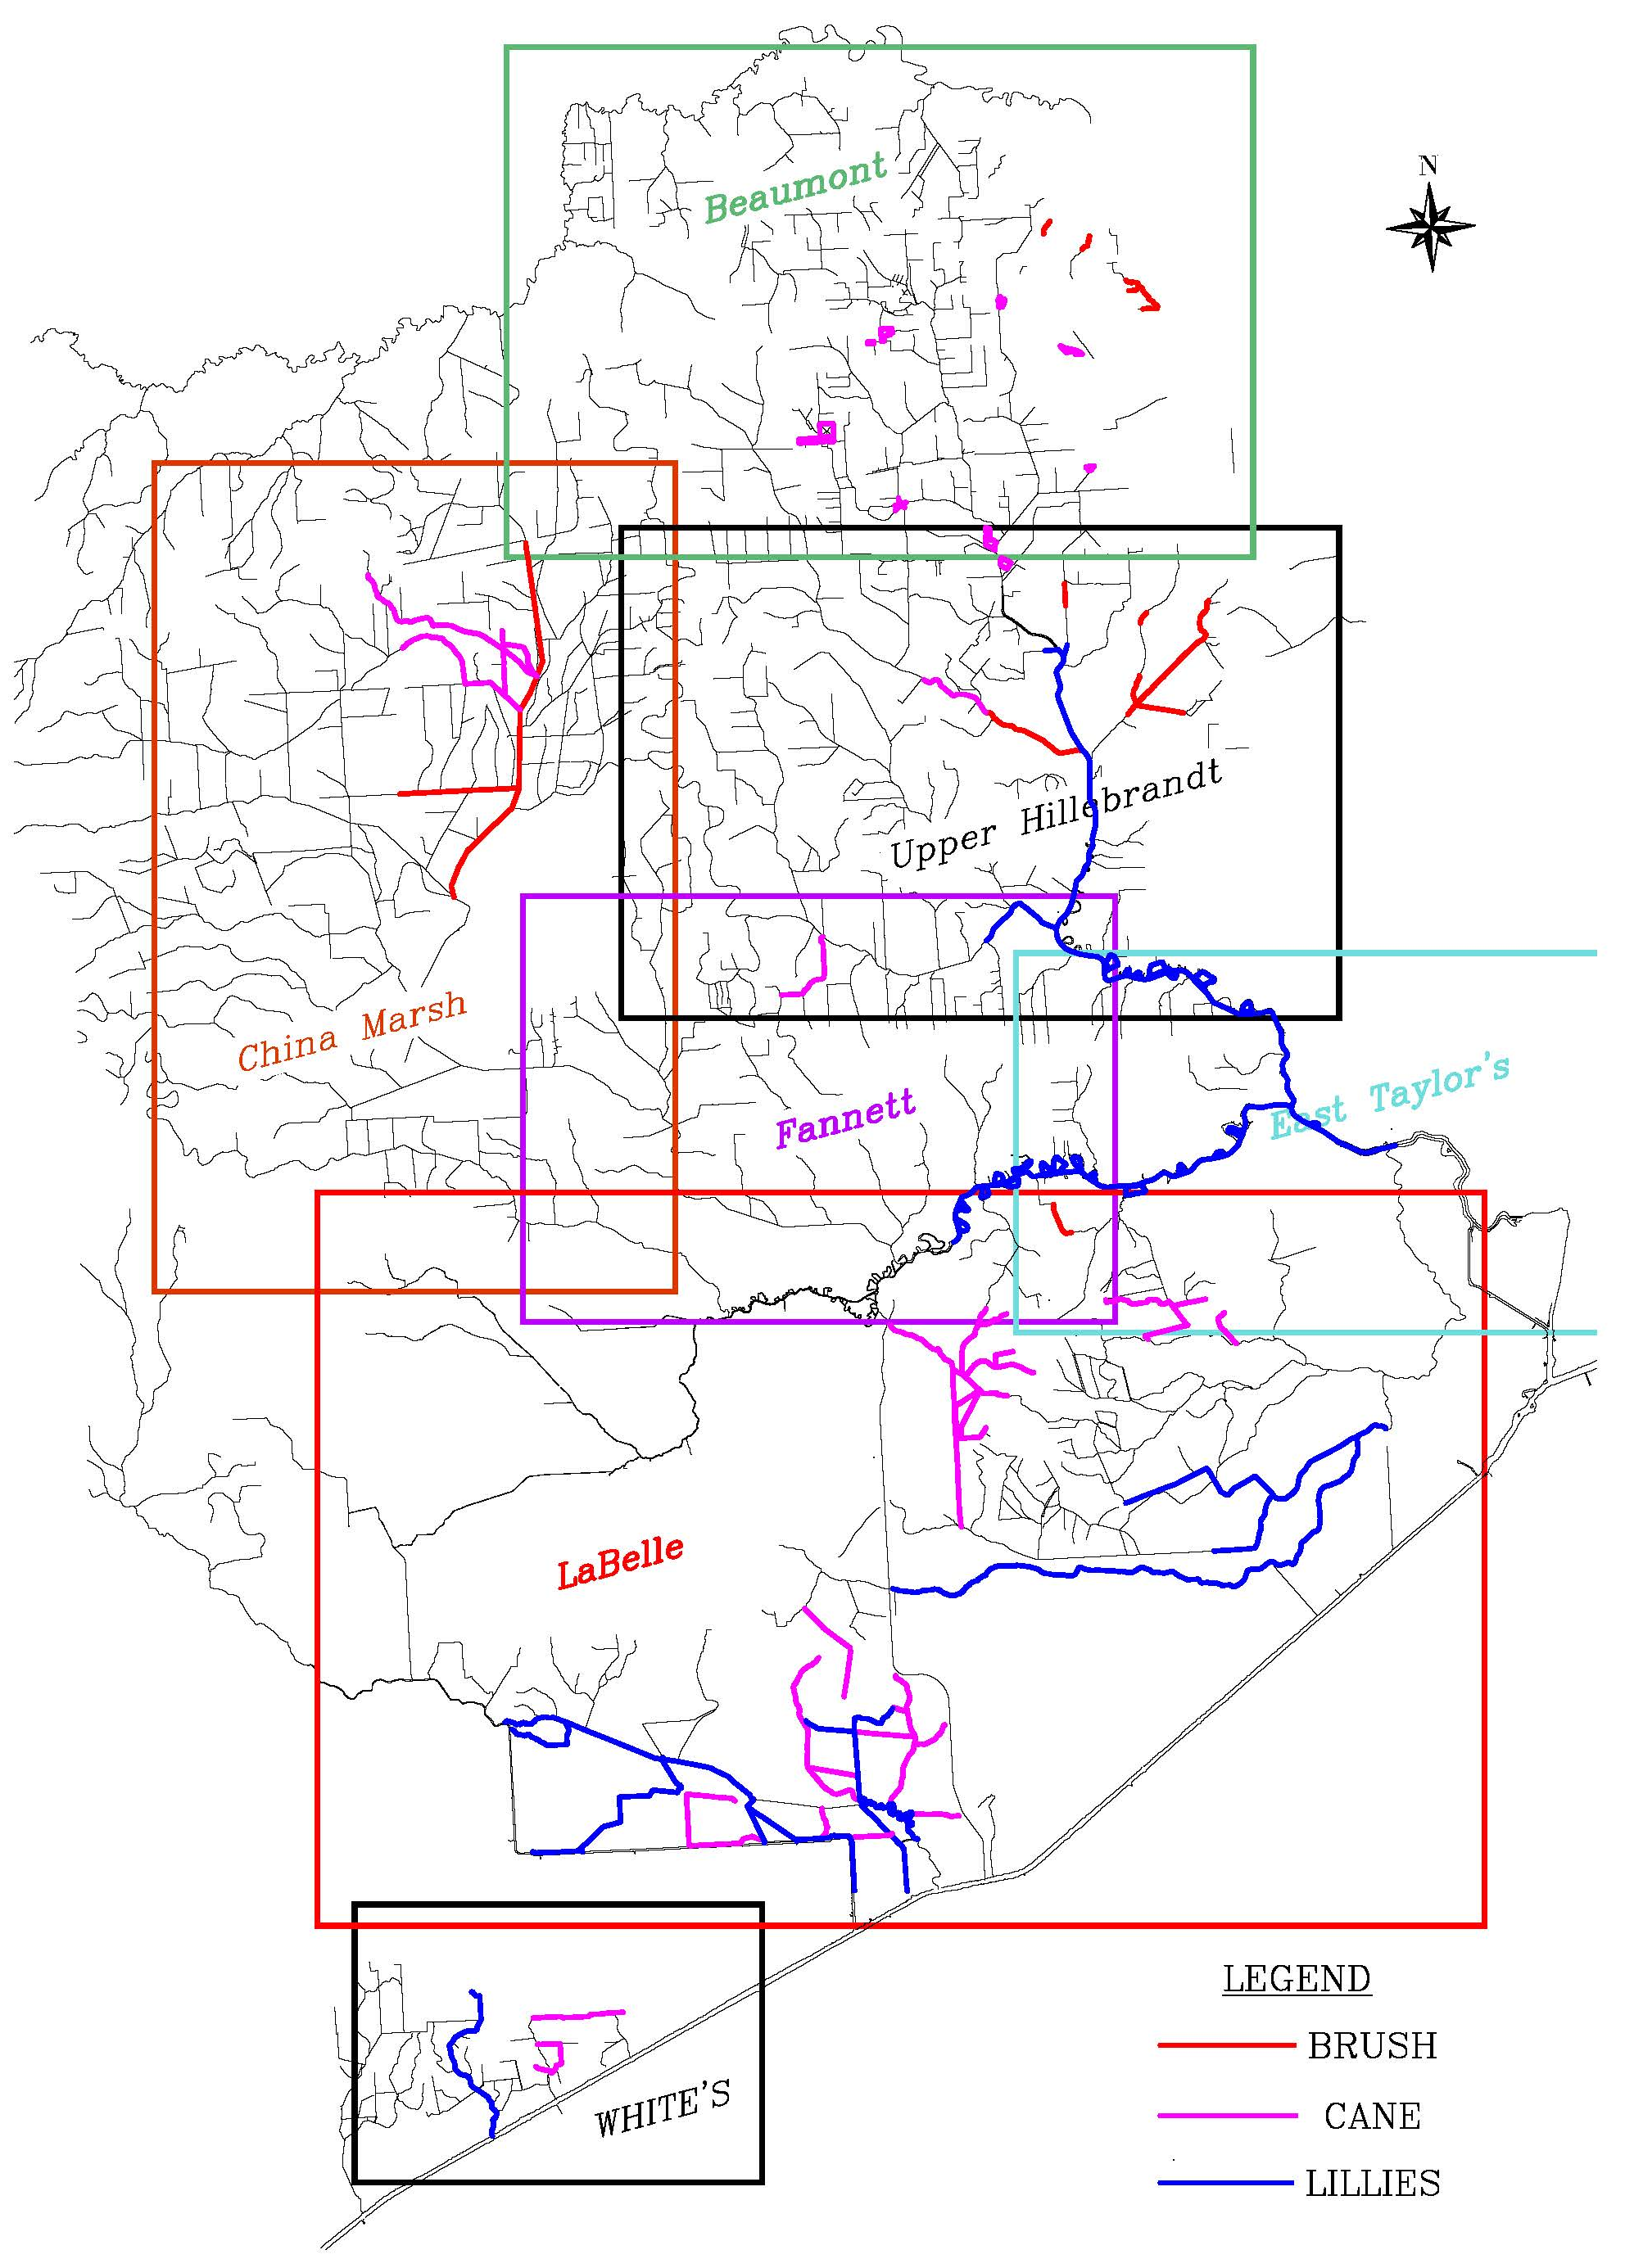
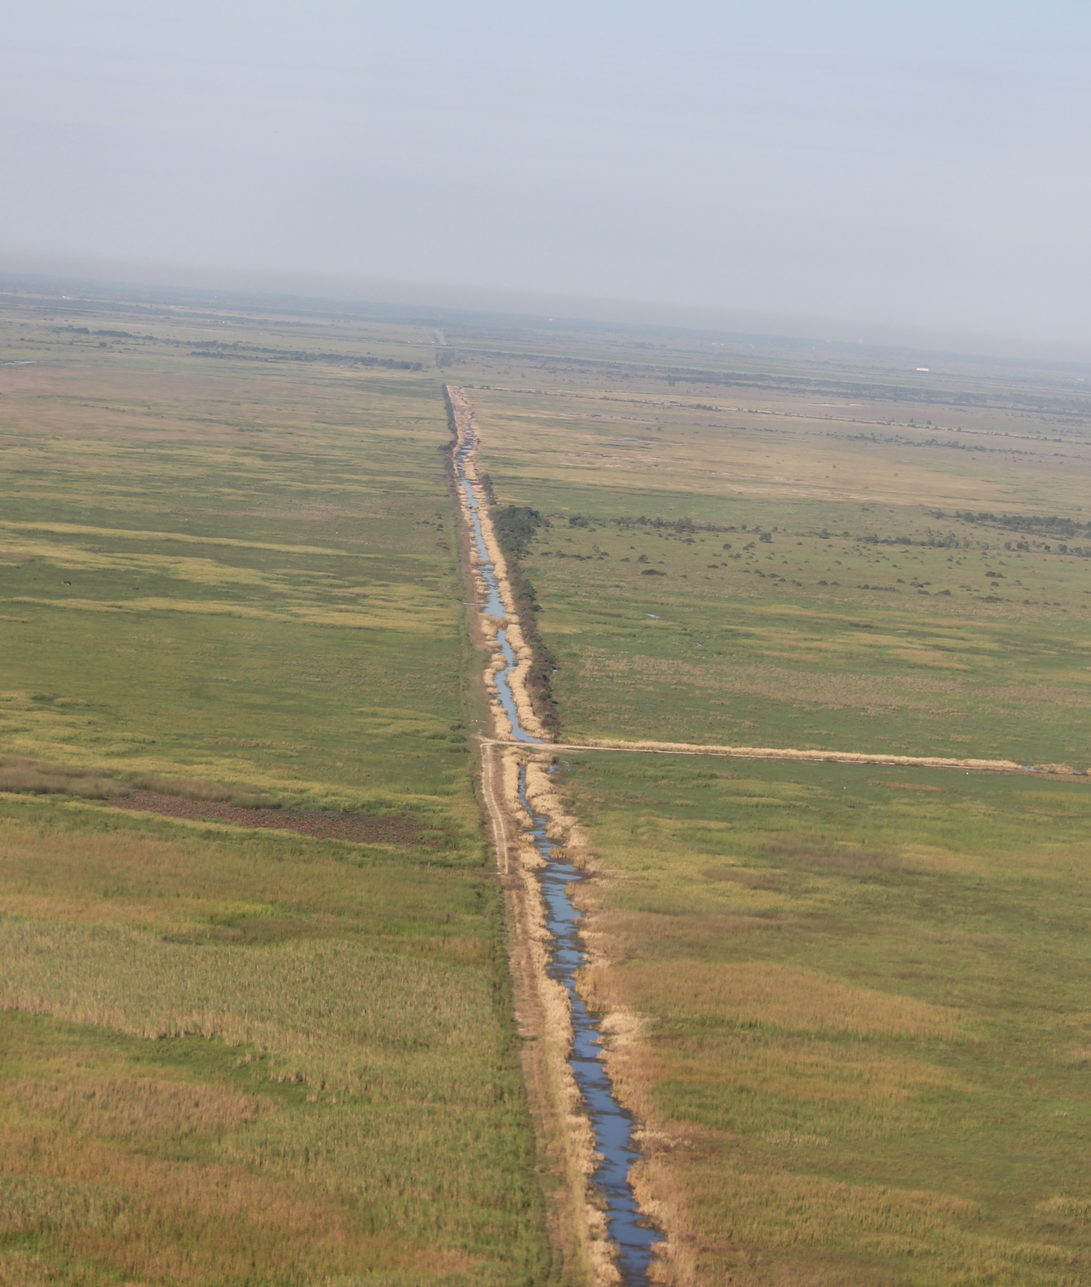
AERIAL HERBICIDE APPLICATION
STARTS 1ST WEEK OF APRIL AND ENDS NOVEMBER/FIRST FROST
TO TARGET AQUATIC AND LAND VEGETATION
• WE UTILIZE CONTRACTOR/HELICOPTER SPRAYING FOR
REMOTE AREAS
• ONCE PER YEAR
• SOMETIMES TWICE PER YEAR BASED
ON VEGETATION GROWTH
SPRAYING AREAS:
• WHITE’S
• LABELLE
• EAST TAYLOR’S
• UPPER HILLEBRANDT
• FANNETT
• CHINA MARSH
• BEAUMONT

Slide 13
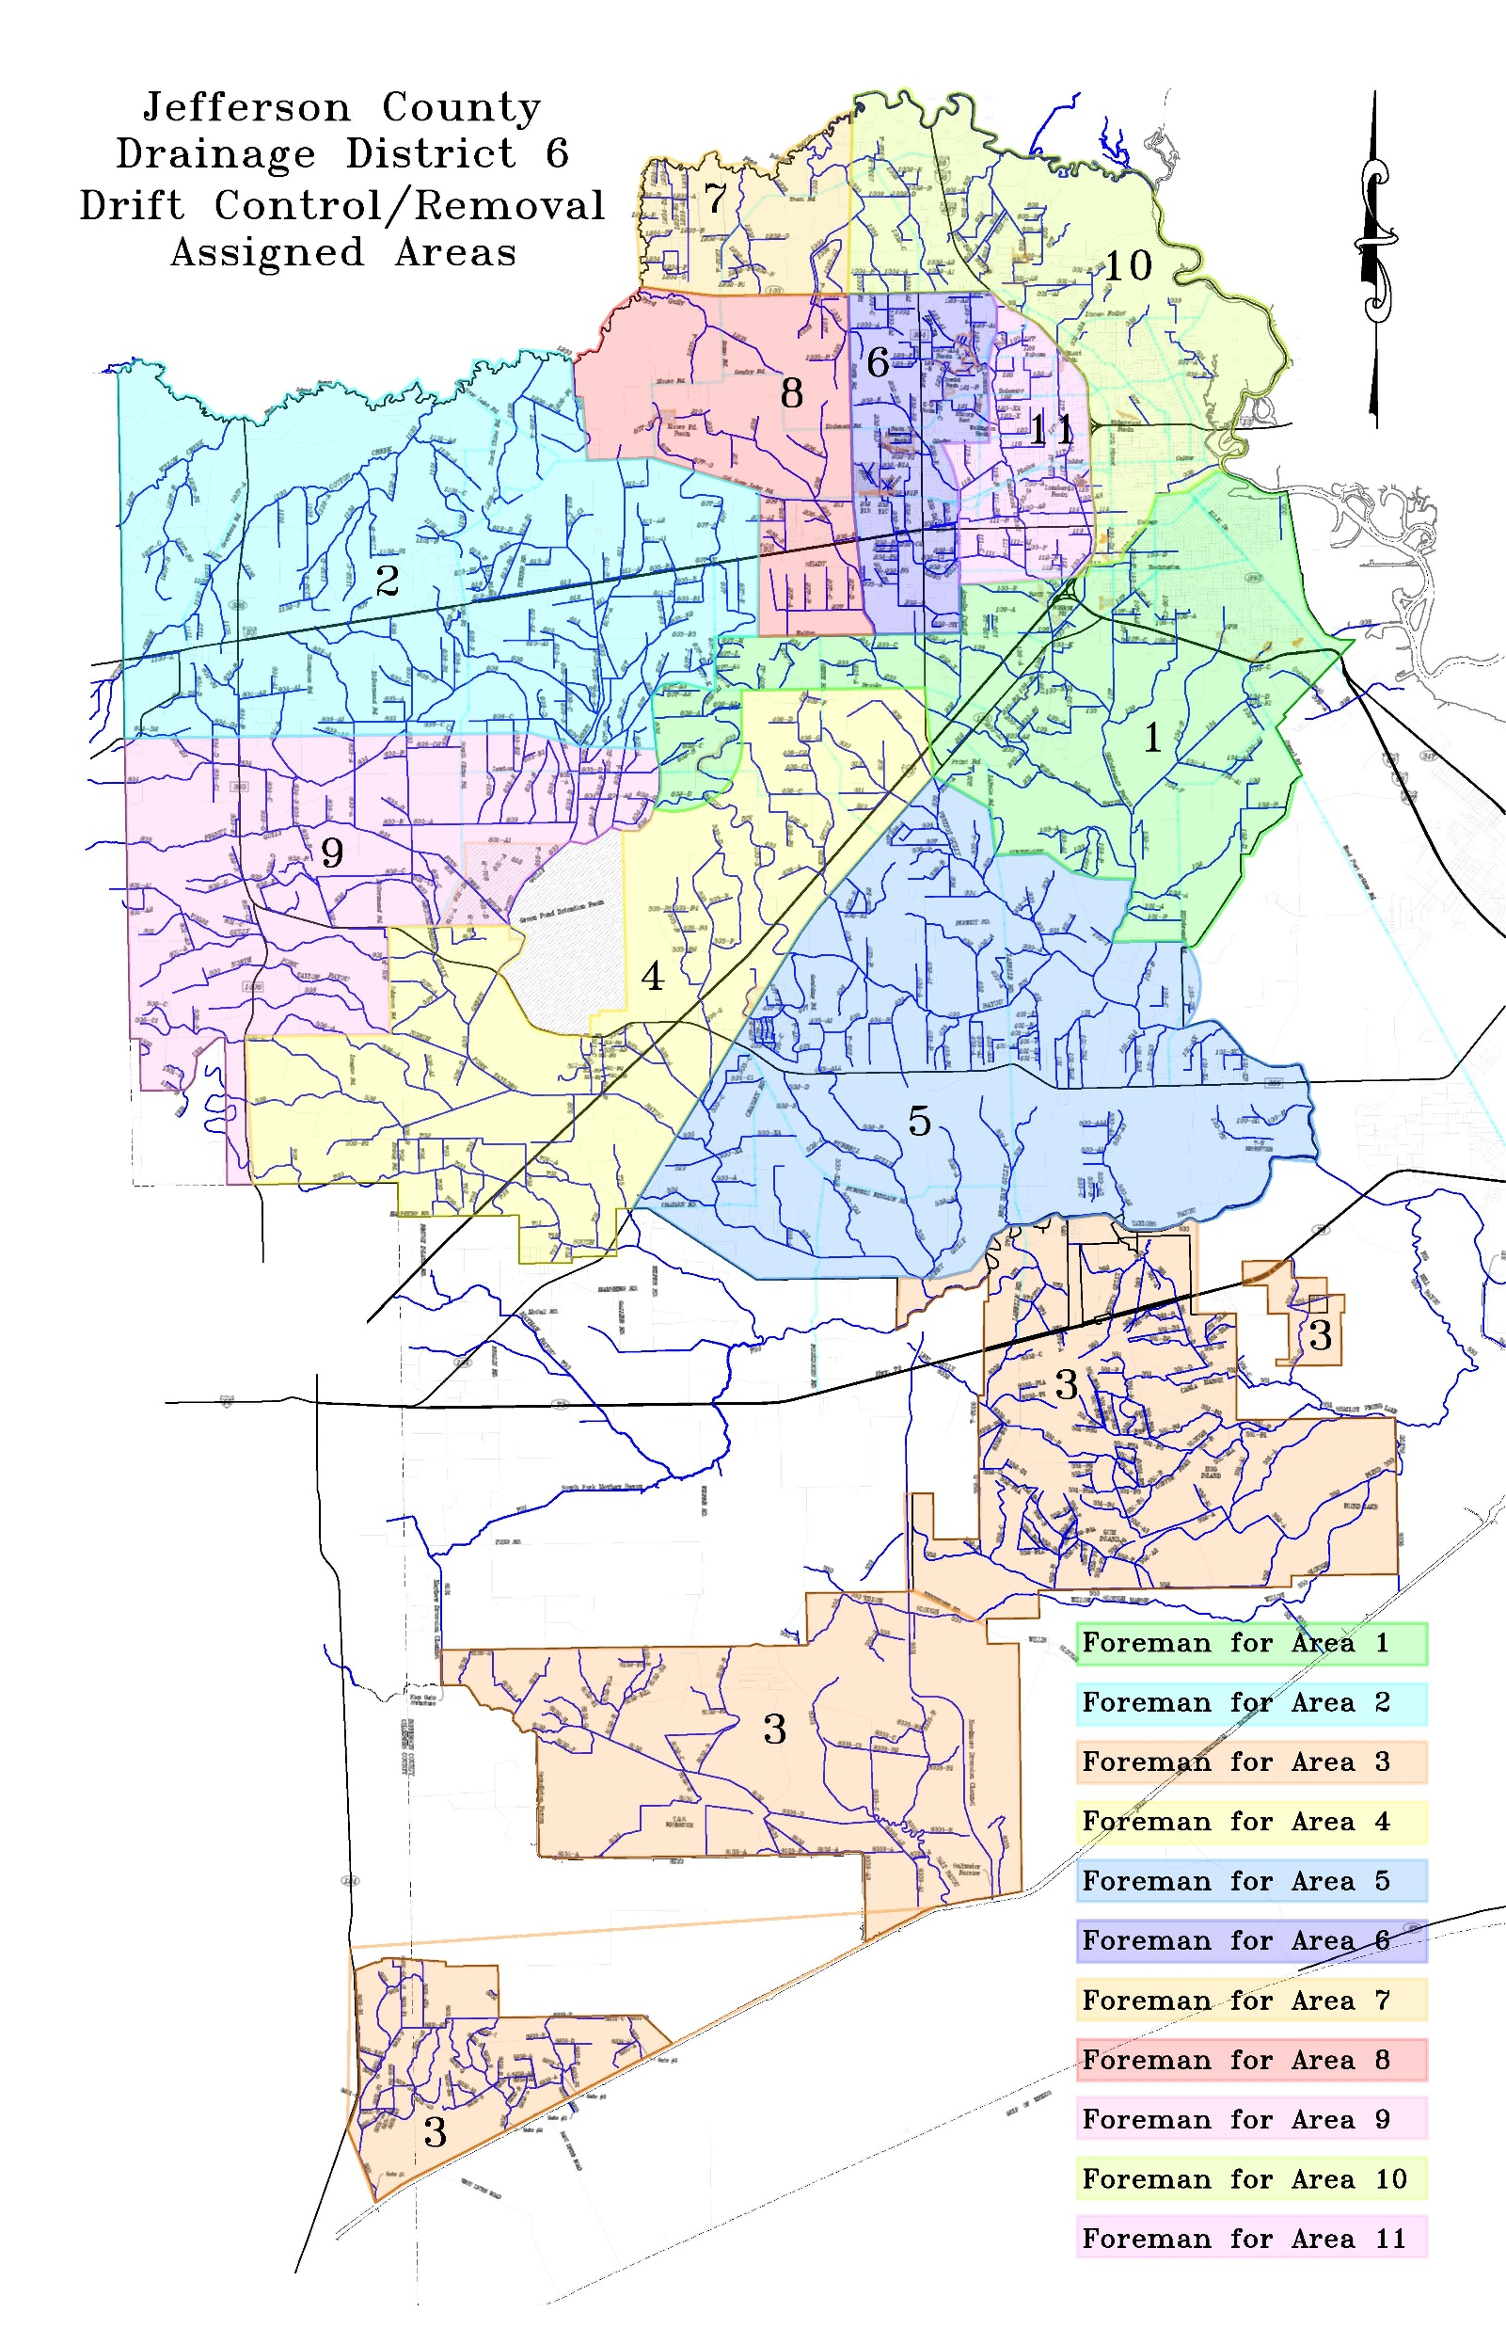
MEASURES TAKEN PRIOR TO STORM EVENTS
• ENSURE ALL CROSSINGS ARE FREE OF DEBRIS *
• VERIFY ALL WATER CONTROL STRUCTURES ARE IN GOOD
WORKING CONDITION
• MOBILIZE/STAGE EQUIPMENT IN STRATEGIC AREAS
THROUGHOUT DD6 SERVICE AREA
*STAFF INSPECTS CHANNELS FOR DEBRIS YEAR-ROUND

Slide 14
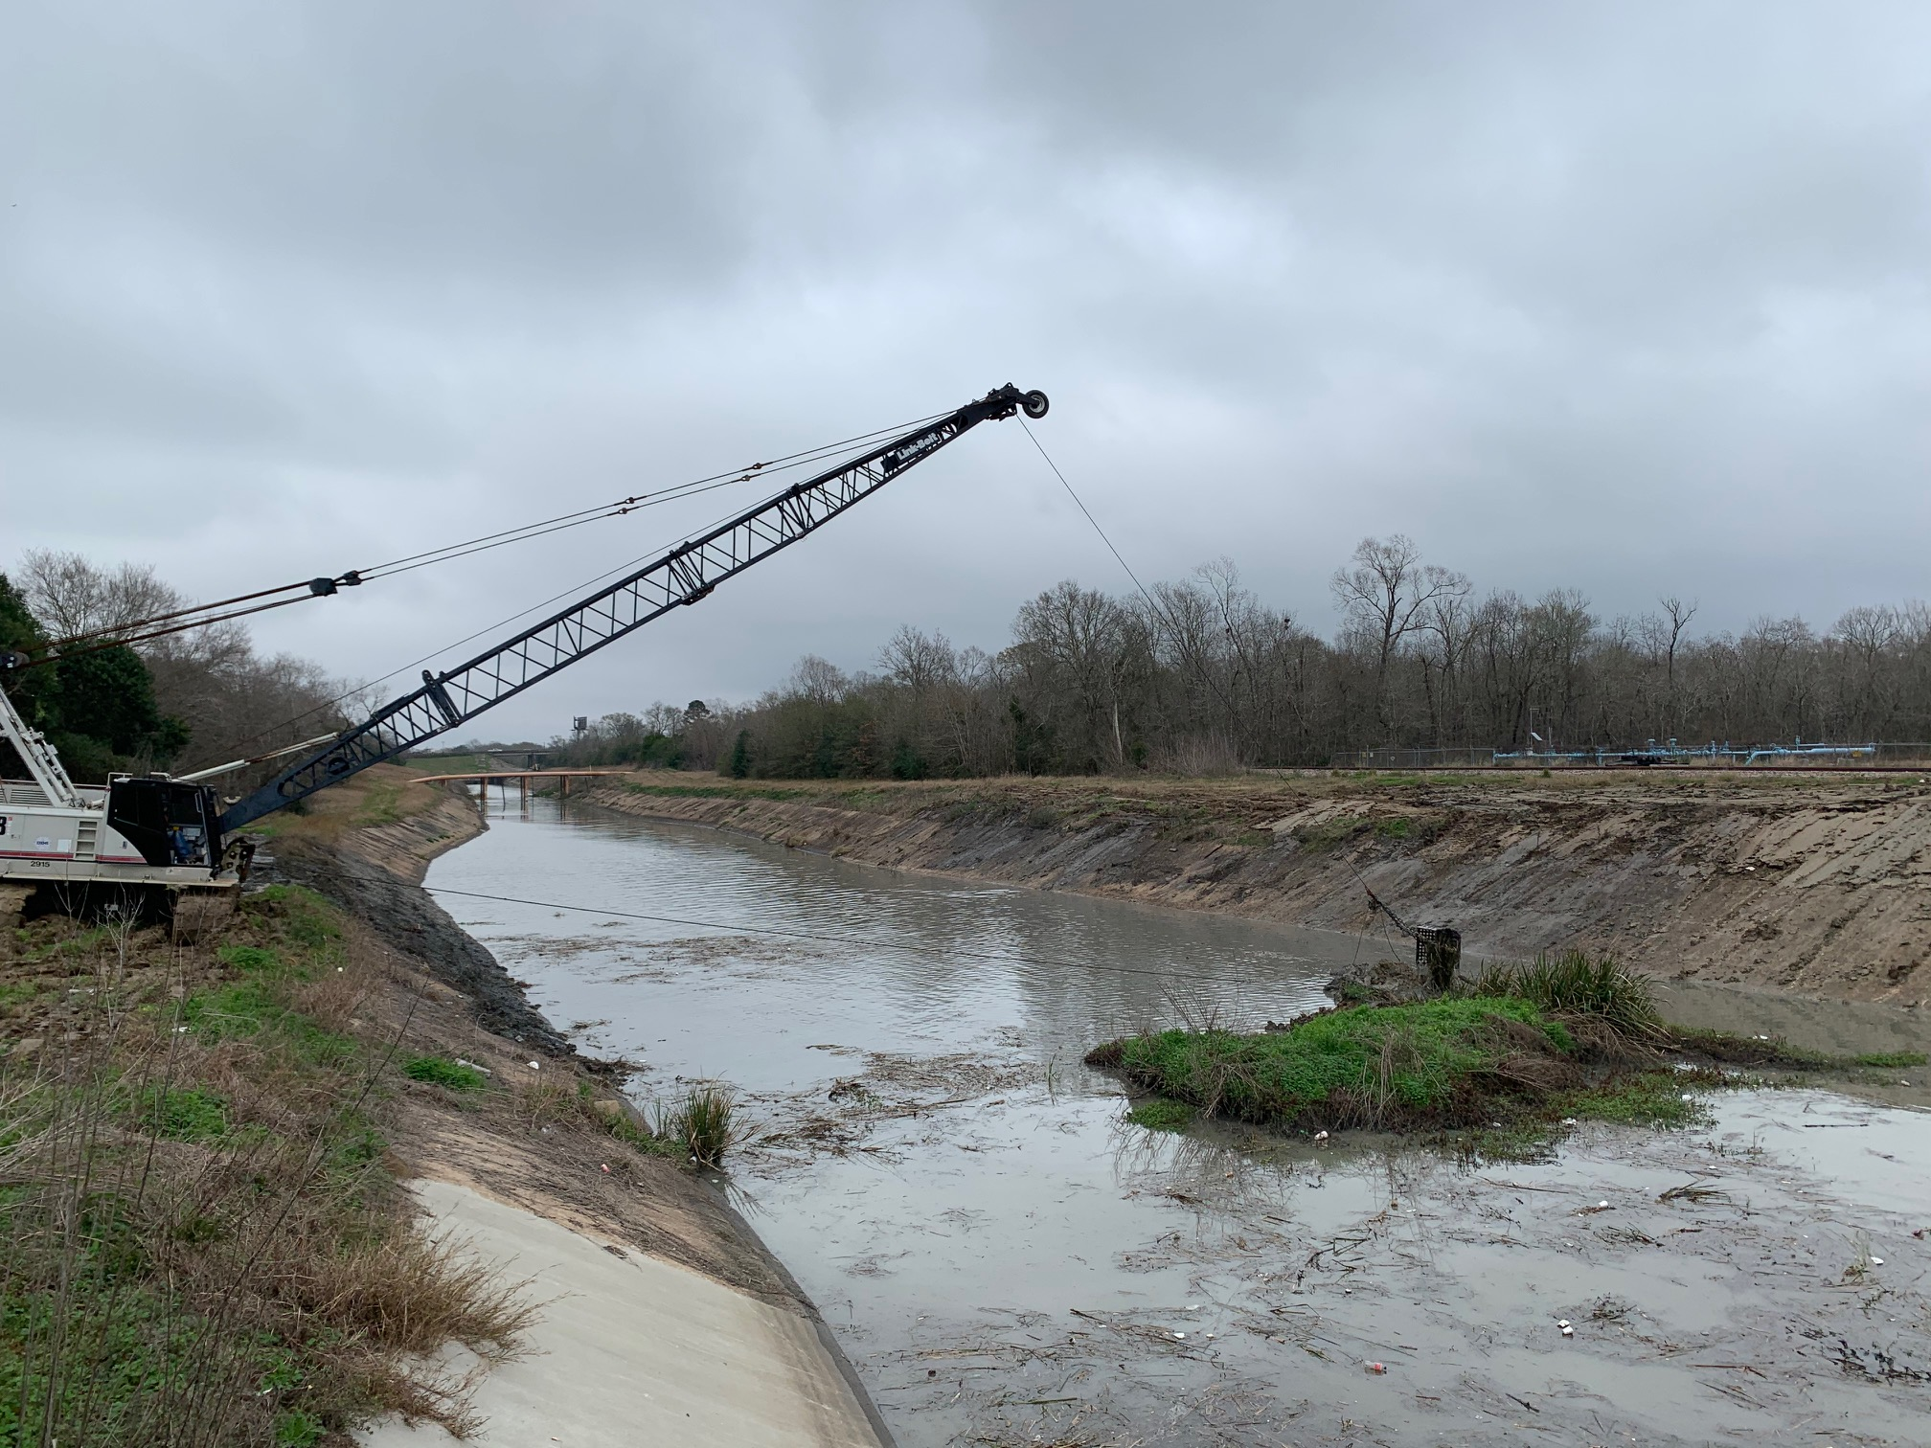
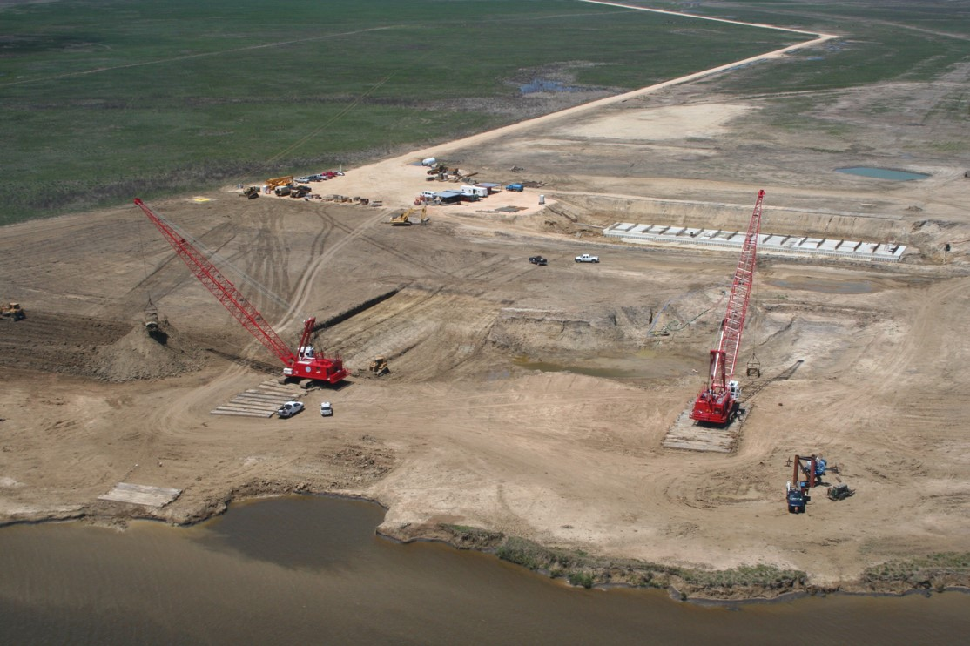
DREDGING OPERATIONS/ASSETS
• DD6
• SMALL DRAGLINE: 60-FOOT BOOM LENGTH RANGE
• YEAR-ROUND
• LINK-BELT 108: 80-FOOT BOOM LENGTH RANGE
UTILIZED FOR PROJECTS AND MAINTENANCE ON AN AS NEEDED BASIS
• CONTRACTOR
• 2 LINK BELT 108s: 80-FOOT BOOM LENGTH RANGE
• YEAR-ROUND

Slide 15
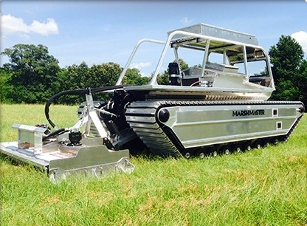
NEW ASSETS
MARSH MASTER®
UTILIZED YEAR-ROUND FOR:
● LIMITED/NARROW ROW
● WET AREAS
● BOTTOM OF DETENTION BASINS
● DITCH BOTTOMS
● ONE MARSH MASTER® IN SERVICE
● ONE MARSH MASTER® ON ORDER

Slide 16
ENGINEERING SUPPORT / PROJECTS
Engineering:
  Planning
  Project Design
  Specifications Preparation
  Project Estimation
  Project Oversight and Administration
  Drainage Studies
  Grant Application and Management Support
  Consulting Engineer Management
Surveying:
  Boundary Location
  Property Acquisition
  Elevation
  Project Layout
  Project As-built
  Global Positioning Systems Surveying (GPS)
  Title Research

Slide 17
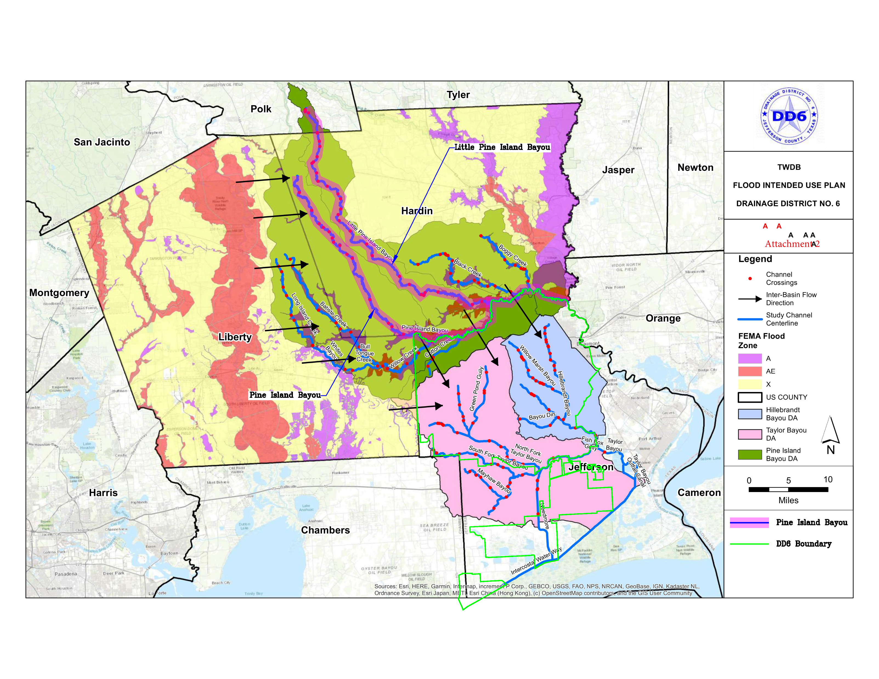
REGIONAL WATERSHED STUDY $8,500,000

Slide 18
Tropical Storm Harvey (2017) GrantS aPplications Approved
UNDER CONSTRUCTION / COMPLETED / WAITING ON CONTRACT
FMA Grants (Harvey) (Flood Mitigation Assistance) Administered by TWDB Project Title for Application | Total Grant | Federal (75%) | Local To Be Paid By State (25%)
Amelia Cutoff Diversion/Detention Project | $4,246,000 | $3,184,500 | $1,061,500
Byrd Gully Relief Project | $711,800 | $533,850 | $177,950
Elinor Street Drainage Project | $1,493,200 | $1,119,900 | $373,300
McLean Street Relief Project | $4,040,580 | $3,030,435 | $1,010,145
HMGP (Harvey) (Hazard Mitigation Grant Program) Administered by TDEM Project Title for Application | Total Grant | Federal (75%) | Local To Be Paid By State (25%)
Ditch 609/S. China Relief Project | $6,615,544 | $4,961,658 | $1,653,886

Slide 19
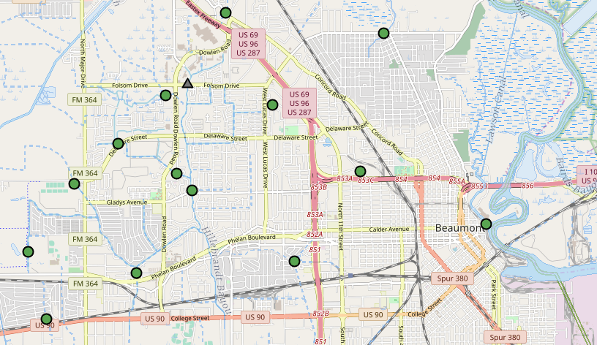
Tropical Storm Harvey (2017) GrantS Application Approved
COMPLETED
FPP Grant (Flood Protection Planning) Administered by TWDB Project Title for Application | Total Grant | Federal (23%) | Local (77%)
ALERT System Upgrade | $607,270 | The lessor of $145,389 or 23% of total costs | $461,881
PROJECT WAS EXPANDED BEYOND THE ORIGINAL SCOPE
AT A TOTAL COST OF $1,100,000

Slide 20
Application has been selected and awarded
IN PROGRESS
State of Texas / FIF (Flood Infrastructure Funds) Administered by TWDB Project Title for Application | Total Grant | State (75%) | Local (25%)
Regional Watershed Study | $8,500,000 | $6,375,000 | $2,125,000

Slide 21
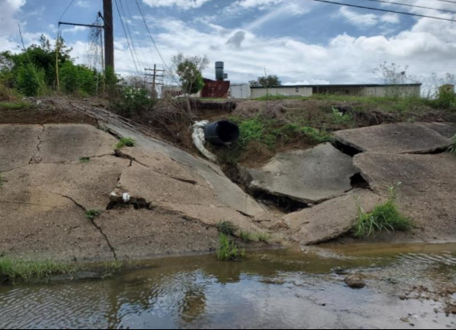
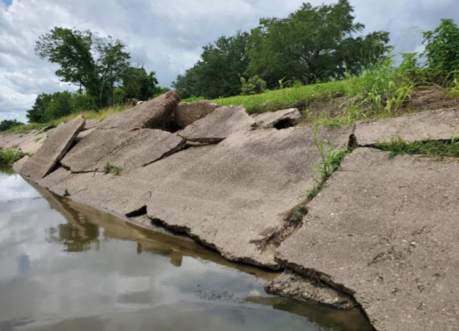
application has been submitted
BRIC Grant (2020) (Building Resilient Infrastructure & Communities) Administered by TWDB Project Title for Application | Total Grant | Federal (75%) | Local (25%)
Channel 100-A Concrete Repairs | $39,570,000 | $29,676,000 | $9,893,000

Slide 22
applications have been submitted chosen for future award
FMA Grants (2020) Administered by TWDB Project Title for Application | Total Grant | Federal (75%) | Local (25%)
Ditch 505 Fannett Detention | $13,520,000 | $10,140,000 | $3,380,000
East China Relief | $2,850,000 | $2,137,500 | $712,500
South Nome Relief | $2,290,000 | $1,717,500 | $572,500

Slide 23
application has been submitted under review
FMA Grant (2020) Administered by TWDB Project Title for Application | Total Grant | Federal Max Paid | Local Obligation
Hazard Mitigation Plan Update | $45,000 | $25,000 | $20,000

Slide 24
applications have been submitted under review
CDBG-MIT Administered by TGLO Project Title for Application | Total Grant | Federal (99%) | Local (1%)
Bayou Din Detention Joint with Jefferson County | $64,040,000 | $63,399,600 | $640,400
Blanchette Diversion Project | $99,745,950 | $98,748,491 | $997,460
South Park Diversion Joint with City of Beaumont | $46,400,000 | $45,936,000 | $464,000
Tevis Diversion Project | $97,985,530 | $97,005,675 | $979,855
Tyrrell Park Detention II | $49,380,000 | $48,886,200 | $493,800

Slide 25
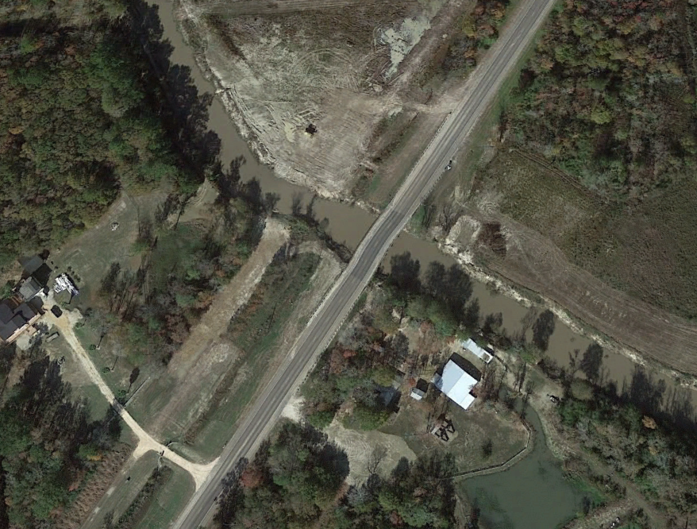
applications have been submitted under design
CDBG-DR Jefferson County Allocation Share Administered by TGLO Project Title for Application | Total Grant | Federal (100%) | Local
Ditch 107 Rehabilitation Project | $958,000 | $958,000 | N/A
Ditch 110-B Rehabilitation Project | $696,000 | $696,000 | N/A
Taylor’s Bayou Drainage Improvements @ SH-124 | $2,500,860 | $2,500,860 | N/A

Slide 26
SUMMARY
• GRANT PROGRAM CRITICAL FOR FUNDING MAJOR PROJECTS
● $150 MIL GRANT PROJECTS SINCE 2003
• NEWLY CREATED SYSTEMATIC MAINTENANCE PROGRAM – TRACKED BY GPS
• RESTORING DD6’S DRAINAGE SYSTEM LOST CAPACITY
• EXPANDING THE MAINTENACE PROGRAM FOR CONCRETE AND EARTHEN CHANNELS
• CITIZEN COMPLAINTS HAVE BEEN SUBSTANTIALLY REDUCED
• THIS IS TESTAMENT TO OUR DEDICATED STAFF THAT WORKS HARD TO MINIMIZE THE RISK OF FLOODING

Slide 27
THANK YOU!
INFORMATIVE WEBSITE:
DD6.ORG
INTERACTIVE MAPS
REAL-TIME RAIN DATA AND WATER LEVELS
LIST OF ONGOING PROJECTS
CONTACT US AT:
(409) 842-1818

